Slide 1
Multi-Factor Authentication and One Time Passwords
Adam Lamers no. 266559

Slide 2
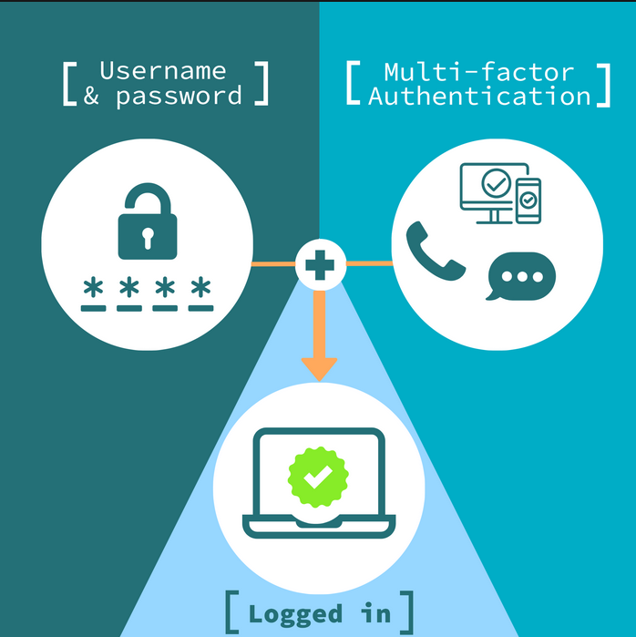
What is Multi-factor authentication?

Slide 3
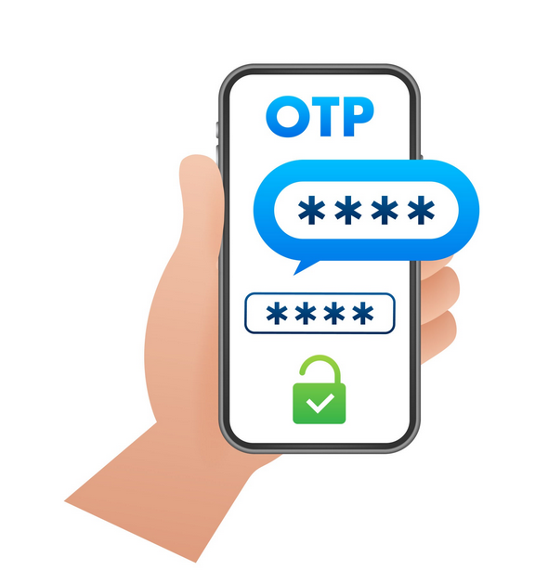
OTP - One Time Password

Slide 4
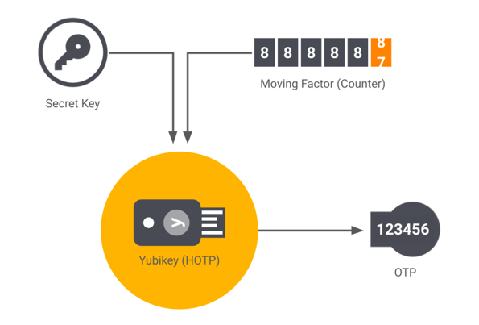
HOTP - HMAC-based one-time password

Slide 5
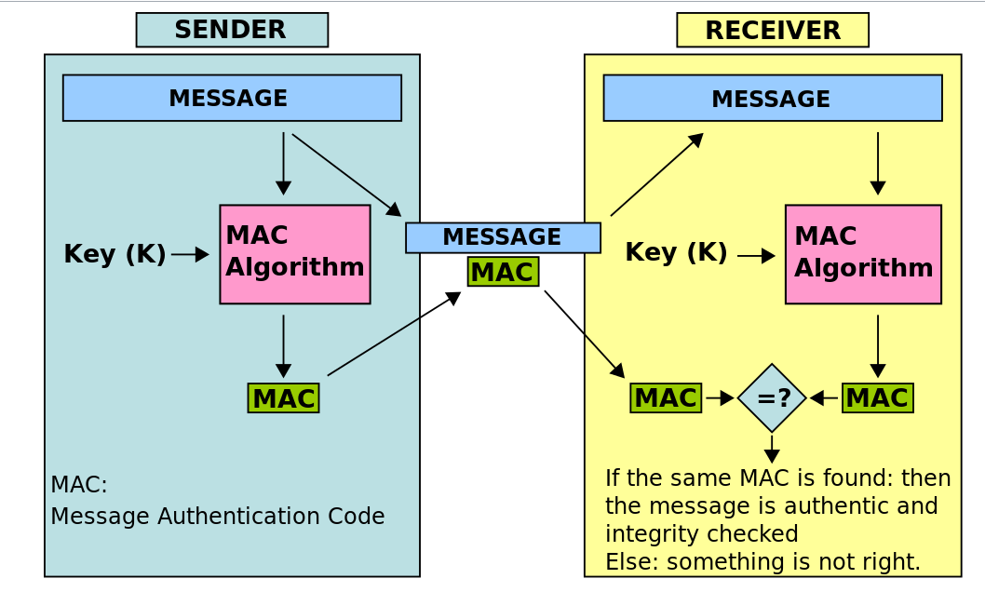
HMAC - Hashed-key MAC

Slide 6
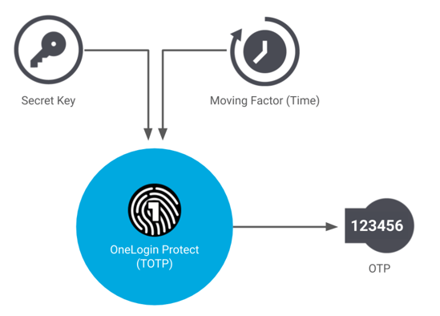
TOTP - Time based One Time Password

Slide 7
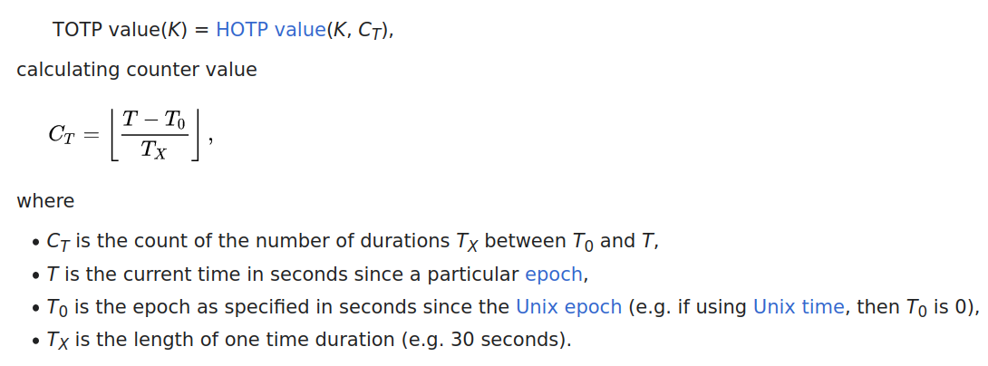
TOTP Calculation

Slide 8


Slide 9

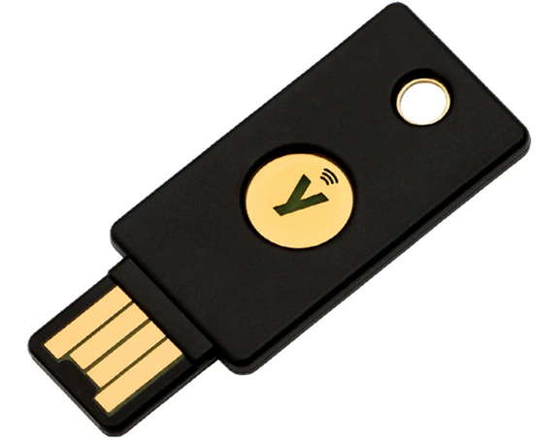
U2F - Universal two factor

Slide 10
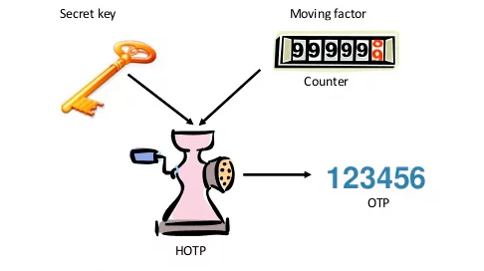


So, what about HOTP?

Slide 11
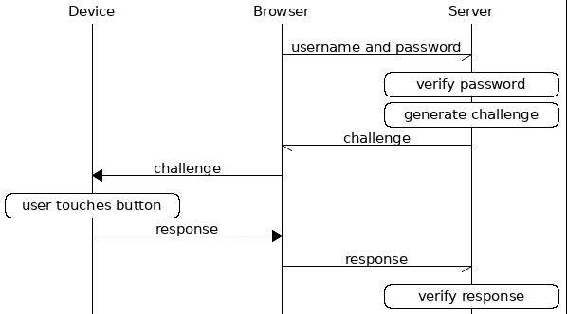
U2F Algorithm

Slide 12
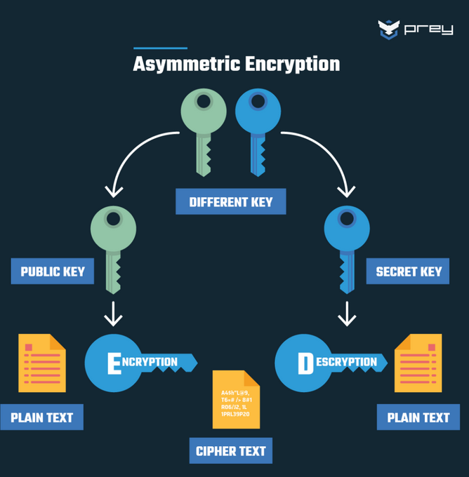
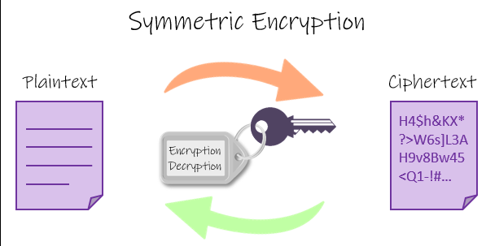
Diffrence between U2F and OAUTH based methods - symmetric and asymmetric encryption

Slide 13
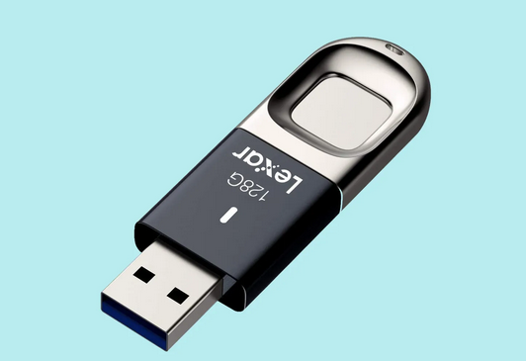
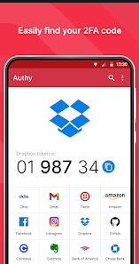
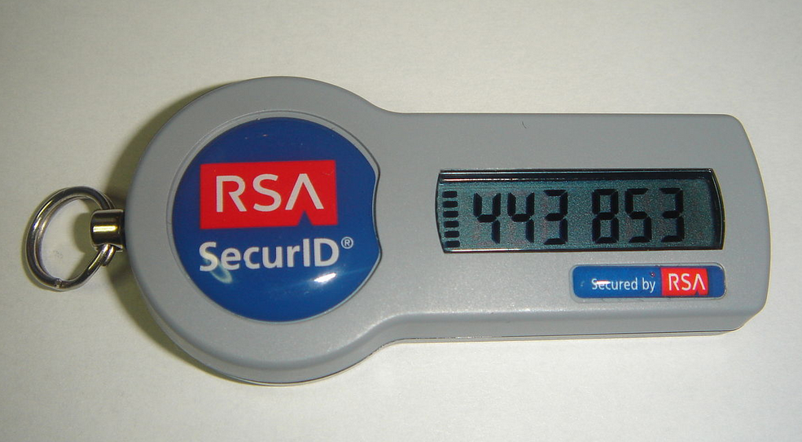
What can be an authenticator?

Slide 14
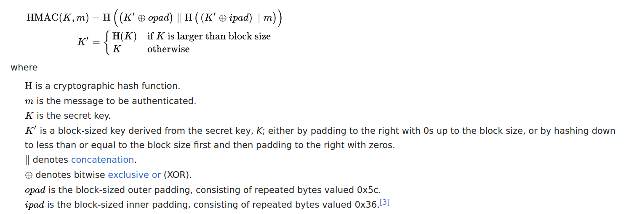
How simple HMAC really is?

Slide 15
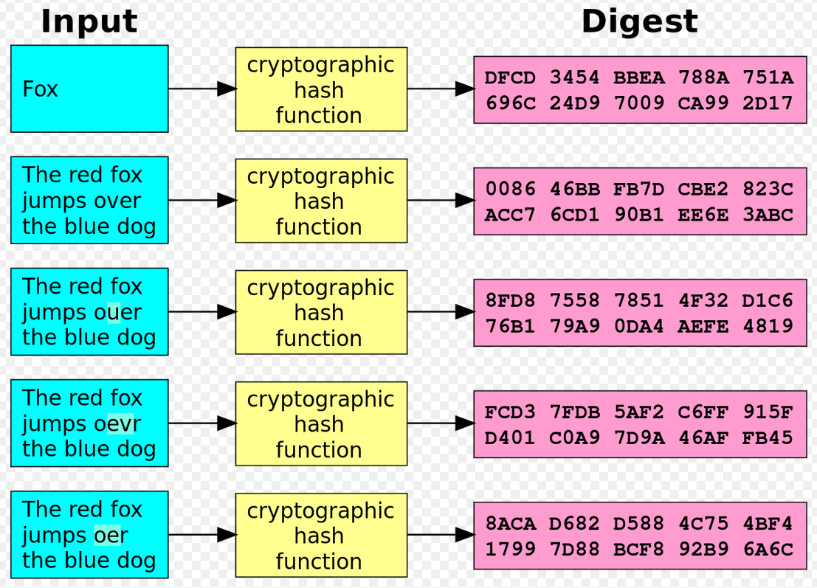
Hash function

Slide 16

Standards for MFA (to be removed)

